Slide 1
Downstream Analysis in R
Niels W. Hanson
Ph.D. Candidate Bioinformatics
Wednesday, February 12 2014
Hallam Laboratory
Hydrocarbon MetaPathways Workshop
The University of British Columbia, Vancouver
https://github.com/nielshanson/mp_tutorial/wiki/Introduction-to-Downstream-Analysis-in-R

Slide 2
Prerequisites
Install Pathway Tools http://biocyc.org/download-bundle.shtml
Perl v5.0 http://www.perl.org/
Downloads
Presentation Slides: MetaPathways_Tutorial_Pathway_Analysis.pdf
HOT Fosmid-end ePGDBs: HOT_Sanger_ePGDBs.zip
Perl Pathway Extractor Script: extract_pathway_table_from_pgdb.pl
ORF Abundance Tables: 1_upper_euphotic_rxn.wide.txt, HOT_Sanger_rxn.wide.txt

Slide 3
Goals of Tutorial
Understand general problems when trying to load tabular formats in R.
Re-ordering data & Subsetting Data Frames
Understanding the 'wide' and 'long' table formats
Using Visualization Frameworks: ggplot2 and lattice

Slide 4
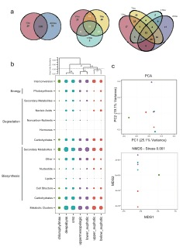

Slide 5
1. Loading Data
Data should be tab-delimited text
pathways_wide <- read.table("../files/HOT_Sanger_pwy.wide.txt", sep="\t", header=T, row.names=1)
hot_metadata <- read.table("../files/HOT_Sanger_ex_var.csv.txt", sep="\t", header=T)
Want to check head(), tail(), and dim() for size in case of bad parsing
Avoid these guys: ;’”`
slicing and dicing with brackets [] and logic
# slicing and dicing
pathways_wide[1,] # first row
pathways_wide[,1] # first column
pathways_wide$X1_upper_euphotic # first factor
logic operators generates Boolean vector
pathways_wide[,1] > 1
[1] FALSE FALSE FALSE FALSE TRUE FALSE FALSE FALSE FALSE TRUE TRUE FALSE FALSE
[14] TRUE FALSE
sum( pathways_wide[,1] > 1 ) gives you the number of TRUE fields

Slide 6
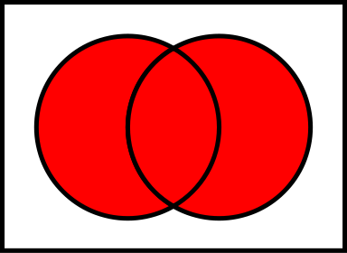
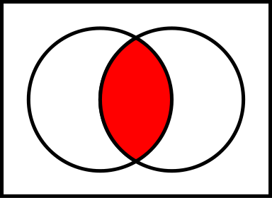
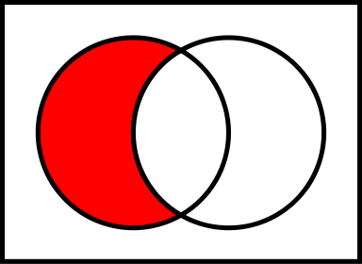
Application: Venn Diagrams
venn_diagram2(), venn_diagram3(), venn_diagram4()
created to do all the set-logic between sets and produce a Venn Diagram
e.g., union, intersect, setdiff
venn_diagram3(setA, setB, setC, “name1”, “name2”, “name3”,
colors = c("#B80830","#EACC33","#46E2D9")
)
combine c() function probably one of the most common in R, used to make a list of arguments. Used everywhere.

Slide 7
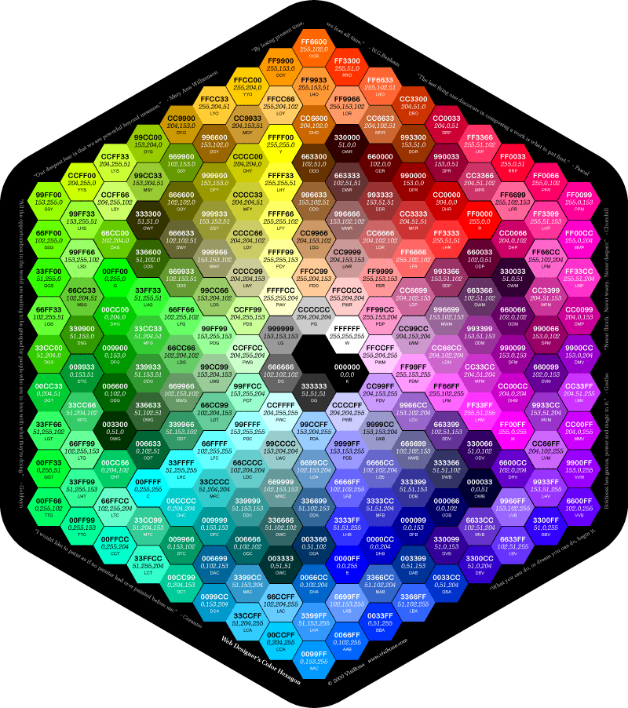
Application: Venn Diagrams
precise colors specified by six hex digits 0-9, A,B,C,D,F #FFFFFF for amounts of red green and blue. Don’t need to memorize, just use for precision.
Get a color picker

Slide 8
Application: Venn Diagrams
# use our newly found skills to identify which pathways had a signal in each
# sample
pwys_10m <- rownames(pathways_wide)[pathways_wide[,"X1_upper_euphotic"] > 0]
pwys_70m <- rownames(pathways_wide)[pathways_wide[,"X6_upper_euphotic"] > 0]
pwys_130m <- rownames(pathways_wide)[pathways_wide[,"X2_chlorophyllmax"] > 0]
pwys_200m <- rownames(pathways_wide)[pathways_wide[,"X3_below_euphotic"] > 0]
pwys_500m <- rownames(pathways_wide)[pathways_wide[,"X5_uppermesopelagic"] > 0]
pwys_770m <- rownames(pathways_wide)[pathways_wide[,"X7_omz"] > 0]
pwys_4000m <- rownames(pathways_wide)[pathways_wide[,"X4_deepabyss"] > 0]
# We can now use these as inputs to the our venn_diagram scripts
venn_10m_and_4000m <- venn_diagram2(pwys_10m, pwys_4000m,
"10m", "4000m")
venn_10m_70m_130m <- venn_diagram3(pwys_10m, pwys_70m, pwys_130m,
"10m", "70m", "130m")
venn_500m_770m_4000m <- venn_diagram3(pwys_500m, pwys_770m, pwys_4000m,
"500m", "770m", "4000m")
venn_10m_70m_130m_200m <- venn_diagram4(pwys_10m, pwys_70m, pwys_130m, pwys_200m,
"10m", "70m", "130m", "200m")
venn_200m_500m_770m_4000m <- venn_diagram4(pwys_200m, pwys_500m, pwys_770m, pwys_4000m,
"200m", "500m", "770m", "4000m")

Slide 9
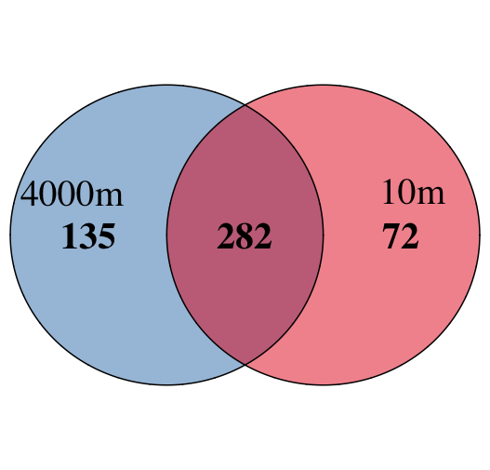
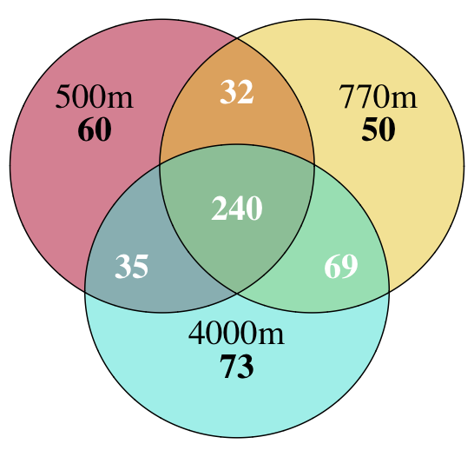
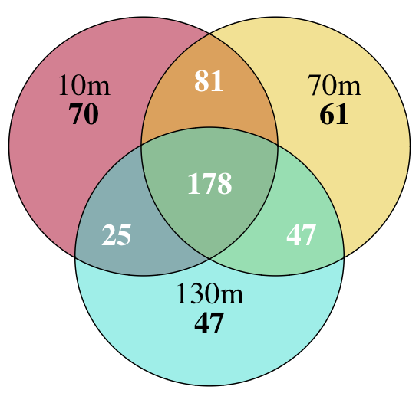
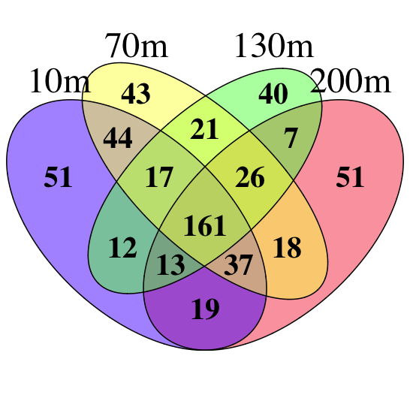
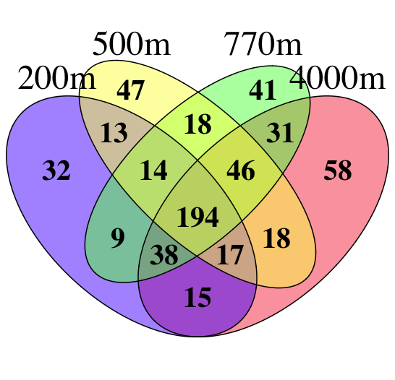
Application: Venn Diagrams

Slide 10
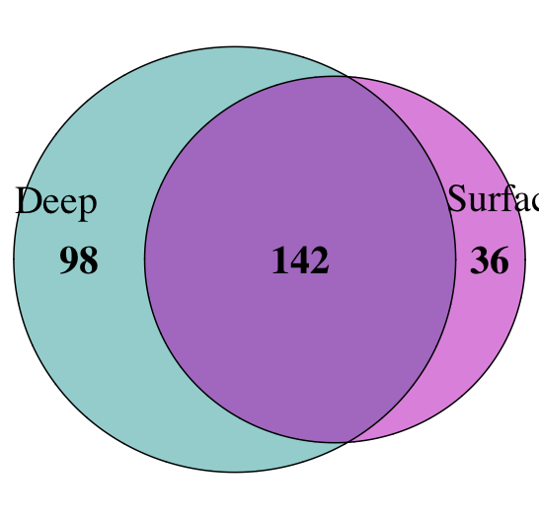
Application: Venn Diagrams
venn_diagram scripts return a list of all sets defined by combining names of sets: - name1_name2: means the intersection of name1 and name2 - name1_only: means only pathways contained in set name1
this can be used to compare the cores of our two triple sets
my_colors = c("#96B4D4", "#ED808B") # custom colors
compare_cores <- venn_diagram2(venn_500m_770m_4000m$"500m_770m_4000m", venn_10m_70m_130m$"10m_70m_130m",
"Deep", "Surface", colors=my_colors, euler=TRUE)

Slide 11
Data distributions
use hist and density to check distribution of data
par(mfrow=c(2,3)) # ready to six images 2x3
pathways_wide.matrix <- as.matrix(pathways_wide)
hist(pathways_wide.matrix)
hist(log(pathways_wide.matrix+1))
hist(sqrt(pathways_wide.matrix))
plot(density(pathways_wide.matrix))
plot(density(log(pathways_wide.matrix+1)))
plot(density(sqrt(pathways_wide.matrix)))
par(mfrow=c(1,1)) # need to set back to 1x1 at end

Slide 12
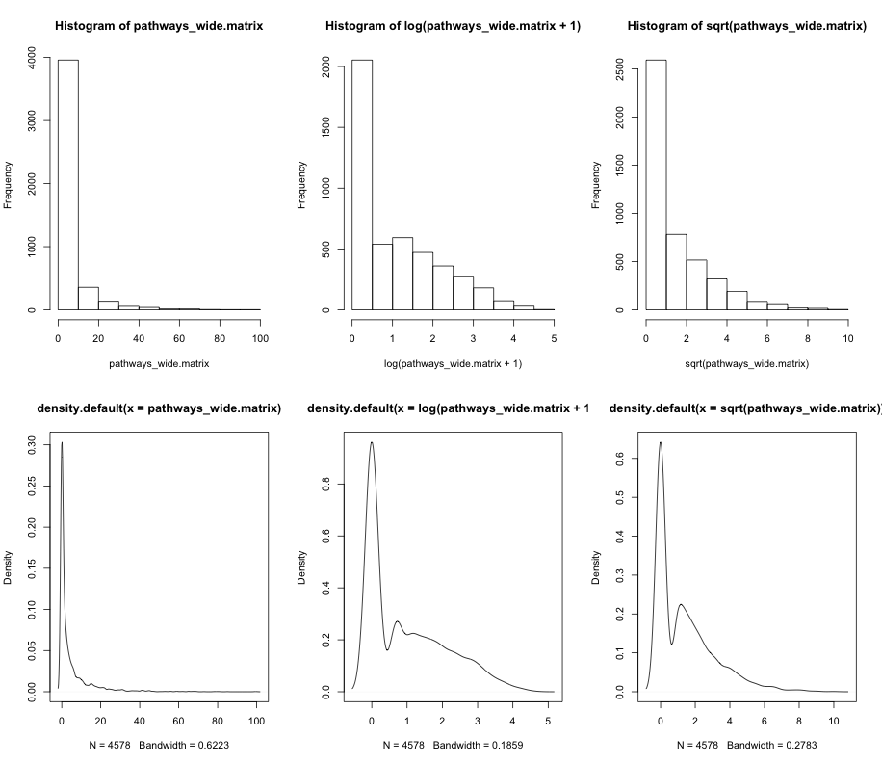
Data distributions
hist()
density()

Slide 13
ggplot2
“Wide” Table Format
 | sample1 | sample2 | sample3
taxa1 | 2 | 5 | 4
taxa2 | 4 | 6 | 9
taxa3 | 2 | 5 | 7
Good for clustering with hclust(), pvclust()
Also valuable to know the transpose t() fxn
Good to have taxa in some kind of acceptable order
“Long” Table Format
taxa | sample | value
taxa1 | sample1 | 2
taxa1 | sample1 | 4
taxa1 | sample1 | 2
taxa2 | sample2 | 5
taxa2 | sample2 | 6
taxa2 | sample2 | 5
taxa3 | sample3 | 4
taxa3 | sample3 | 9
taxa3 | sample3 | 7
Good for plotting in visualization libraries ggplot() and lattice() which need to be classified as a measured or categorical variable

Slide 14
wide to long
To prepare to use ggplot2 and lattice packages. We are going to transform our wide table to a long table format using melt() from the reshape2 package
# add pathways from rowsnames to matrix
pathways_wide$pwy = rownames(pathways_wide)
# go from wide to long table format
pathways_long <- melt(pathways_wide)
colnames(pathways_long)[2] = "samp”
pathways_long$samp <- sub("X","", pathways_long$samp)
# add long pathway names
meta_17 <- read.table("../files/meta_17.txt", sep="\t", header=T, row.names=1)
pathways_long$pwy_long = meta_17[pathways_long$pwy,1]
# download metacyc hierarchy & level the factors
meta_17_hier <- read.table("../files/meta_17_hierarchy.txt", sep="\t", header=F, row.names=1)
meta_17_hier$V3 <- factor(meta_17_hier$V3, levels=unique(meta_17_hier$V3))
meta_17_hier$V4 <- factor(meta_17_hier$V4, levels=unique(meta_17_hier$V4))
meta_17_hier$V5 <- factor(meta_17_hier$V5, levels=unique(meta_17_hier$V5))

Slide 15
wide to long
# add pathways from rowsnames to matrix
pathways_wide$pwy = rownames(pathways_wide)
# go from wide to long table format
pathways_long <- melt(pathways_wide)
colnames(pathways_long)[2] = "samp”
pathways_long$samp <- sub("X","", pathways_long$samp)
# add long pathway names
meta_17 <- read.table("../files/meta_17.txt", sep="\t", header=T, row.names=1)
pathways_long$pwy_long = meta_17[pathways_long$pwy,1]
# download metacyc hierarchy & level the factors
meta_17_hier <- read.table("../files/meta_17_hierarchy.txt", sep="\t", header=F, row.names=1)
meta_17_hier$V3 <- factor(meta_17_hier$V3, levels=unique(meta_17_hier$V3))
meta_17_hier$V4 <- factor(meta_17_hier$V4, levels=unique(meta_17_hier$V4))
meta_17_hier$V5 <- factor(meta_17_hier$V5, levels=unique(meta_17_hier$V5))

Slide 16
wide to long
# add additional pathway levels
pwy_level1 <- meta_17_hier[pathways_long$pwy,2]
pwy_level2 <- meta_17_hier[pathways_long$pwy,3]
pathways_long <- cbind(pathways_long, pwy_level1)
pathways_long <- cbind(pathways_long, pwy_level2)
# small correction for pathways not found in hierarchy
missing <- setdiff(unique(pathways_long$pwy), rownames(meta_17_hier))
pathways_long <- pathways_long[!(pathways_long$pwy %in% missing),]
# order pathways first by level V3 and then by V4
pwy_order <- intersect(rownames(meta_17_hier[order(meta_17_hier[,"V3"], meta_17_hier[,"V4"]),]),
unique(pathways_long$pwy))
# factor pathways and then the samples
pathways_long$pwy <- factor(pathways_long$pwy, levels = pwy_order)
pathways_long$samp <- factor(pathways_long$samp, levels = hot_metadata$sample)
# whew, you got the longtable

Slide 17
ggplot2
Anatomy of a ggplot call. First you call the main ggplot function with the data frame and an aesthetics function aes() to specify x= and y= variables
library(ggplot2)
g <- ggplot(DataFrame, aes(x=samp,y=pwy_level1))
After this you add feature to the plot that can be driven by your data factors, e.g. geom_point
g <- g + geom_point(aes(size=sqrt(value), color=samp))
geom_abline, geom_bar, geom_boxplot, geom_density, geom_errorbar,
geom_histogram, geom_rect, geom_smooth, geom_tile, geom_violin
Each point has its own aesthetics values to change, which gives you powerful set of options to create a variety of plots
http://docs.ggplot2.org/0.9.3.1/geom_bar.html

Slide 18
ggplot2
The facet_wrap or facet_grid functions allow you to plot multiple subsets of your data on one plot based on some category or condition
facet_wrap(~ samp)

Slide 19
ggplot2 in action
g <- ggplot(subset(pathways_long, value >0),
aes(x=samp, y=pwy_level1)) +
geom_point(aes(size=sqrt(value), color=samp)) +
theme_bw() +
theme(axis.text.x = element_text(angle = 90, vjust = 0.5, hjust = 1)) +
labs(x = "Samples", y = "Pathways")
g

Slide 20
ggplot2 in action
g <- ggplot(subset(pathways_long, value >0), aes(x=samp,y=pwy_level2)) +
geom_point(aes(size=sqrt(value), color=samp)) + theme_bw() +
theme(axis.text.x = element_text(angle = 90, vjust = 0.5, hjust = 1)) +
labs(x = "Samples", y = "Pathways")

Slide 21
ggplot2 in action
If your first call to aes only has one factor it assumes you want to count it. So in this case it will count all pathways in the different pwy_level1 classes
g <- ggplot(pathways_long, aes(pwy_level1)) +
geom_bar(aes(fill=samp)) +
theme_bw() +
coord_flip() +
facet_wrap(~ samp, ncol = 7)
g

Slide 22
ggplot2 in action
g <- ggplot(pathways_long, aes(pwy_level2)) +
geom_bar(aes(fill=samp)) + theme_bw() + coord_flip() +
facet_wrap(~ samp, ncol = 7)
g

Slide 23
ggplot2 in action
g <- ggplot(pathways_long, aes(pwy_level2, fill=samp)) +
geom_bar() + theme_bw() + coord_flip()
g

Slide 24
ggplot2 in action
g <- ggplot(pathways_long, aes(value)) +
geom_density( aes(fill=samp, alpha=0.6)) + facet_wrap(~ samp, ncol=7) +
theme_bw() + theme(legend.position="none")
g

Slide 25
ggplot2 in action
g <- ggplot(pathways_long, aes(value)) +
geom_histogram( aes(fill=samp)) + facet_wrap(~ samp, ncol=7) +
theme_bw() + theme(legend.position="none")
g

Slide 26
qplot
“quick plot” a simpler version of ggplot2, but in generally harder to get full control
Hadley’s Was Here (He is Loud!) Lecture UBC May 2013 - http://www.mathtube.org/lecture/video/visualising-data-ggplot2
Hadley covers it in a lot more detail

Slide 27
learn more
Google is your friend, i.e., how do I do “X” in ggplot2? or I’m getting error “Y” in ggplot2
Really Struggling? http://www.r-tutor.com/r-introduction
There are also a number of websites: ggplot2 doc - http://docs.ggplot2.org/0.9.3.1/index.html Cookbook for R - http://www.cookbook-r.com/
Sit down and experiment to learn structure
Quick R – Lots of examples of getting things done http://www.statmethods.net/
Jeff Leek – http://blog.revolutionanalytics.com/2013/04/coursera-data-analysis-course-videos.html
Getting better: Experimentation and experience make all the difference.

